Slide 1

BCS2313: Artificial Intelligence Techniques
Modul 2.1:
BASIC SEARCH STRATEGIES

Slide 2

Learning Objectives
Problem Types
Problem Formulation
Basic Search Algorithms

Slide 3
Problem Types

Slide 4
Problem Types
Deterministic, fully observable → single-state problem
Agent knows exactly which state it will be in; solution is a sequence
Non-observable → sensorless problem (conformant problem)
Agent may have no idea where it is; solution is a sequence
Nondeterministic and/or partially observable → contingency problem
percepts provide new information about current state
often interleave} search, execution
Unknown state space → exploration problem

Slide 5
Problem Formulation

Slide 6

Problem Formulation (Eg: A Romanian Holiday)
On holiday in Romania; currently in Arad.
Flight leaves tomorrow from Bucharest
Formulate goal:
be in Bucharest
Formulate problem:
states: various cities
actions: drive between cities
Find solution:
sequence of cities, e.g., Arad, Sibiu, Fagaras, Bucharest

Slide 7
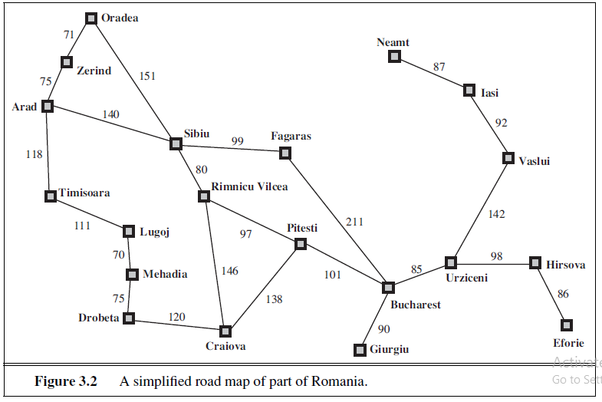
Problem Formulation (Eg: A Romanian Holiday)
Source: : Russell and Norvig, “Artificial Intelligence: A Modern Approach”. 3rd Edition

Slide 8
Problem Formulation (Conti..)
A problem space can be defined formally by FIVE (5) components:
State representation
Initial State
Goal State
Operators
Path cost

Slide 9
Problem Formulation (Conti..)
Problem space:
State space: Cities in Romania
Initial state: Town of Arad
Goal: Airport in Bucharest
Operators: Drive between cities
Path cost: number of cities, distance, time, fuel
Solution: Sequence of cities

Slide 10
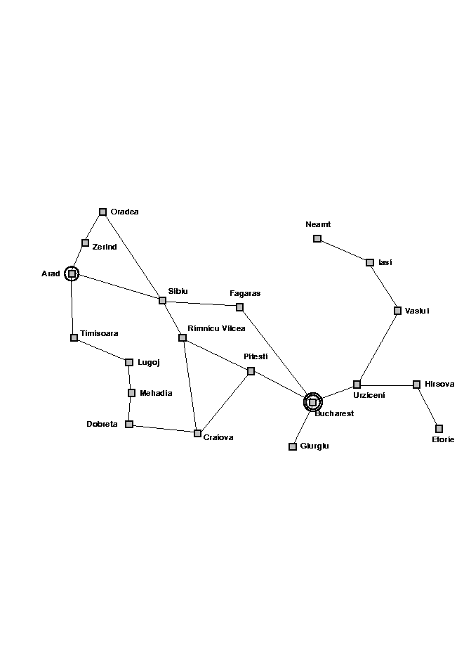
The State Space

Slide 11
Representing Search
Arad
Zerind
Sibiu
Timisoara
Arad
Oradea
Fagaras
Rimnicu Vilcea
Sibiu
Bucharest

Slide 12

Solution

Slide 13
Problem Formulation (Conti..)
Let’s consider the River Problem:
A farmer wishes to carry a wolf, a duck and corn across a river, from the south to the north shore. The farmer is the proud owner of a small rowing boat called Bounty which he feels is easily up to the job. Unfortunately the boat is only large enough to carry at most the farmer and one other item. Worse again, if left unattended the wolf will eat the duck and the duck will eat the corn.
Q: How can the farmer safely transport the wolf, the duck and the corn to the opposite shore?
River
boat
Farmer, Wolf,
Duck and Corn

Slide 14
Problem Formulation (Conti..)
The River Problem:
F=Farmer W=Wolf D=Duck C=Corn /=River
How can the farmer safely transport the wolf, the duck and the corn to the opposite shore?
-/FWCD
FWCD/-
https://www.novelgames.com/en/wolf/

Slide 15
Problem Formulation (Conti..)
Problem space components:
State representation: location of farmer and items in both sides of river
[items in South shore / items in North shore] : (FWDC/-, FD/WC, C/FWD …)
Initial State: farmer, wolf, duck and corn in the south shore FWDC/-
Goal State: farmer, duck and corn in the north shore
-/FWDC
Operators: the farmer takes in the boat at most one item from one side to the other side
(F-Takes-W, F-Takes-D, F-Takes-C, F-Takes-Self [himself only])
Path cost: the number of crossings

Slide 16
Problem Formulation (Conti..)
State space:
A problem is solved by moving from the initial state to the goal state by applying valid operators in sequence. Thus the state space is the set of states reachable from a particular initial state.
Initial state
Dead ends
Illegal states
repeated state
intermediate state
Goal state

Slide 17
Problem Formulation (Conti..)
Searching for a solution:
We start with the initial state and keep using the operators to expand the parent nodes till we find a goal state.
…but the search space might be large…
…really large…
So we need some systematic way to search.

Slide 18
Problem Formulation (Conti..)
Problem solution:
A problem solution is simply the set of operators (actions) needed to reach the goal state from the initial state:
F-Takes-D, F-Takes-Self, F-Takes-W,
F-Takes-D, F-Takes-C, F-Takes-Self,
F-Takes-D.

Slide 19
Problem Formulation (Conti..)
Problem solution: (path Cost = 7)
While there are other possibilities here is one 7 step solution to the river problem
F
D
D
F
W
D
F-Takes-D
F-Takes-S
F-Takes-W
F
W
D
C
W
C
F
W
C
C
Initial State
WC/FD
FWC/D
C/FWD
F-Takes-D
F
W
G
C
W
C
F
W
C
W
F-Takes-D
F-Takes-S
F-Takes-C
F
D
D
F
D
C
Goal State
FD/WC
D/FWC
FDC/W

Slide 20
Problem Formulation (Game 1)
Let’s consider The Missionaries and Cannibals problem:
On one bank of a river are three missionaries and three cannibals. There is one boat available that can hold up to two people and that they would like to use to cross the river. If the cannibals ever outnumber the missionaries on either of the river’s banks, the missionaries will get eaten.
Q: How can the boat be used to safely carry all the missionaries and cannibals across the river?
http://www.novelgames.com/en/missionaries/

Slide 21

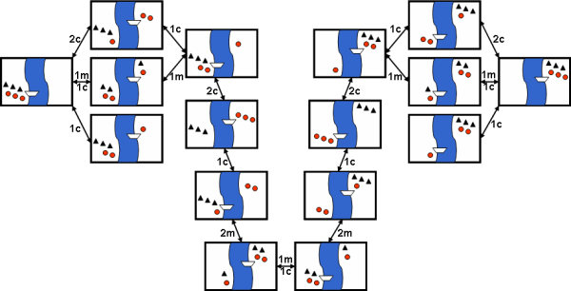
Problem Formulation (Game 1)
The initial state is shown to the right here, where black triangles represent missionaries and red circles represent cannibals.
Path cost= 11

Slide 22

Problem Formulation (Game 2)
Let’s consider Everybody Has To Cross The River problem:
The following are rules which apply:
The raft can take only two persons at the same time.
The father cannot stay with any of the daughters without the presence of the mother.
The mother cannot stay with any of the sons without the presence of the father.
The thief (with striped shirt) cannot stay with any family member without the presence of the policeman.
The raft can only be operated by the policeman, the father and the mother.
http://www.japaneseiqtest.net/

Slide 23
Problem Formulation (Game 2)
Instructions to Solve the Test:
Start by moving the thief and policeman together across. Then, take only the policeman back.
One of the sons and the policeman can cross the river together. The policeman would then bring the thief back.
The remaining son and the father can cross next. Then, only the father will return. At this point, the two sons will be across the river by themselves.
The mother and father will go across at the same time. Then, the mother will return leaving the two sons and the father on the other side.
The thief and policeman will cross together, while the father goes back alone. Now, the thief, the policeman and the two sons will be on the other side.
Once again the mother and the father will go across, but the mother will go back alone.
One of the daughters and the mother will cross, while the policeman goes back with the thief.
The policeman will bring the other daughter across and leave the thief alone. After that, the policeman will return by himself to carry the thief across.

Slide 24
Basic Search Algorithms

Slide 25
Generic Search Algorithms
Basic Idea: Off-line exploration of state space by generating successors of already-explored states (also known as expanding states).
Function GENERAL-SEARCH (problem, strategy)
returns a solution or failure
Initialize the search tree using the initial state of problem
loop do
if there are no candidates for expansion, then return failure
Choose a leaf node for expansion according to strategy
if node contains goal state then return solution
else expand node and add resulting nodes to search tree.
end

Slide 26
Implementation of Generic Search Algorithm (Romanian Holiday)
function general-search(problem, QUEUEING-FUNCTION)
nodes = MAKE-QUEUE(MAKE-NODE(problem.INITIAL-STATE))
loop do
if EMPTY(nodes) then return "failure"
node = REMOVE-FRONT(nodes)
if problem.GOAL-TEST(node.STATE) succeeds then return solution(node)
nodes = QUEUEING-FUNCTION(nodes, EXPAND(node, problem.OPERATORS))
end
A nice fact about this search algorithm is that we can use a single algorithm to do many kinds of search. The only difference is in how the nodes are placed in the queue. The choice of queuing function is the main feature.

Slide 27
Key Issues of State-Space search algorithm
Search process constructs a “search tree”
root is the start node
leaf nodes are:
unexpanded nodes (in the nodes list)
“dead ends” (nodes that aren’t goals and have no successors because no operators were applicable)
Loops in a graph may cause a “search tree” to be infinite even if the state space is small
changing definition of how nodes are added to list leads to a different search strategy
Solution desired may be:
just the goal state
a path from start to goal state (e.g., 8-puzzle)

Slide 28
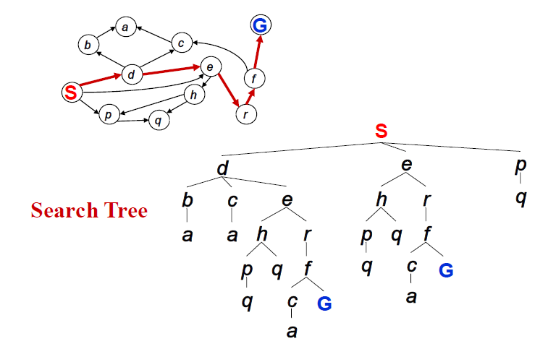
State Space VS Search Trees

Slide 29
Type of Search Algorithms
uninformed( Blind) search: breadth-first, depth-first, depth limited, iterative deepening (IDA), and bidirectional search
informed (Heuristic) search: search is guided by an evaluation function: Greedy best-first, A*, IDA*, and beam search
optimization in which the search is to find an optimal value of an objective function: hill climbing, simulated annealing, genetic algorithms, Ant Colony Optimization
Game playing, an adversarial search: minimax algorithm, alpha-beta pruning

Slide 30
Measuring problem-solving performance
As we are going to consider different techniques to search the problem space, we need to consider what criteria we will use to compare them.
Completeness: Is the technique guaranteed to find an answer (if there is one).
Optimality/Admissibility : does it always find a least-cost solution?
- an admissible algorithm will find a solution with minimum cost
Time Complexity: How long does it take to find a solution.
Space Complexity: How much memory does it take to find a solution.

Slide 31
Time and Space Complexity?
Time and space complexity are always considered with respect to some measure of the problem difficulty.
Time and space complexity are measured in terms of:
The average number of new nodes we create when expanding a new node is the (effective) branching factor b.
The (maximum) branching factor b is defined as the maximum nodes created when a new node is expanded.
The length of a path to a goal is the depth d.
The maximum length of any path in the state space m.

Slide 32
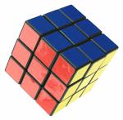
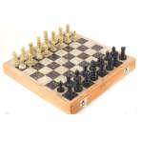
Branching factors for some problems
The eight puzzle has a (effective) branching factor of 2.13, so a search tree at depth 20 has about 3.7 million nodes: O(b^{d})
Rubik’s cube has a (effective) branching factor of 13.34. There are 901,083,404,981,813,616 different states. The average depth of a solution is about 18.
Chess has a branching factor of about 35, there are about 10¹²⁰ states (there are about 10⁷⁹ electrons in the universe).
2
1
3
4
7
6
5
8

Slide 33

33

